Slide 1


Research Project : rainbow algorithm in reinforcement learning
Author : Paul Carfantan
Tutor : Emmanuel Rachelson
March 2019 – June 2019
Notes:
PEER Research project
Team SuReLI (Supaero Reinforcement Learning Initiative) + Emmanuel Rachelson

Slide 2
outline
Background
PIR Topic
Methods & Results
Conclusions

Slide 3
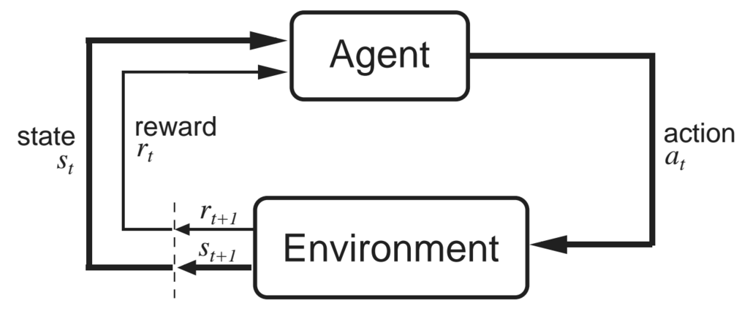
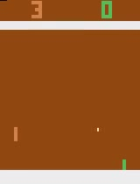
Background
Reinforcement Learning (RL)
- Agent
- State
- Action
- Reward
(b) Deep Q-Network
Notes:
First : need to define some essential notions !
Reinforcement Learning = field of Artificial Intelligence
Basically easier to understand through game (ex. PONG) → the Environment will be the game of Pong
What we call the agent is the decision taker → here the computer
It is in a state (certain position of the game)
The agent choses an action (UP / DOWN)
The environment (PONG) is updated, giving a new state (the positions have changed) and a reward (+1 if win, -1 if lose, 0 otherwards)
The agent takes a new decision for which action to take now

Slide 4
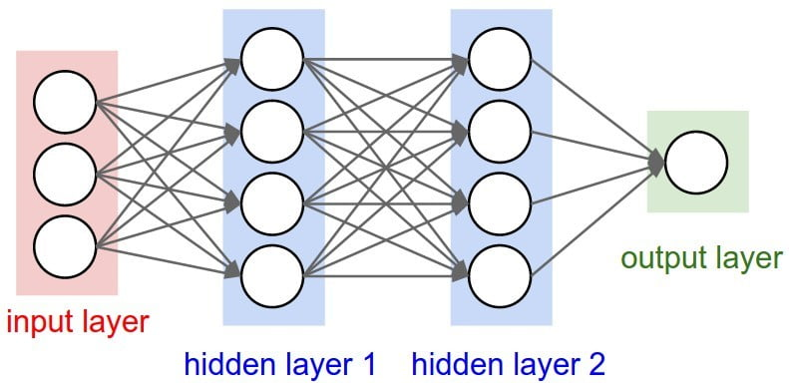
Background
(a) Reinforcement Learning (RL)
(b) Deep Q-Network (DQN)
- Neural Networks
- Which action to chose ?
- Loss function
Notes:
Deep Q Networks :
Neural network = complex computational function approximator
Composed of many elementary units (neurons) connected in layers
We give it an array of numbers in input, returns an other array (different size) of numbers
The neurons are parameters of the network and their values (weights) can be modified
=> change the behavior of the neural network
The final objective is that we give a state as input → it tells us the best action to choose
(in fact : estimates the long-term reward for each action => thanks to that, easy to choose)
For that, the network has to be trained = weights

Slide 5
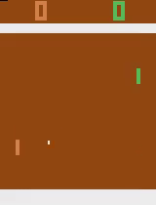
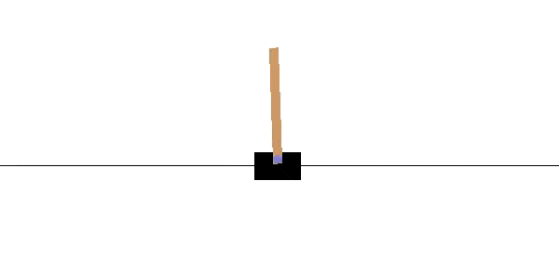
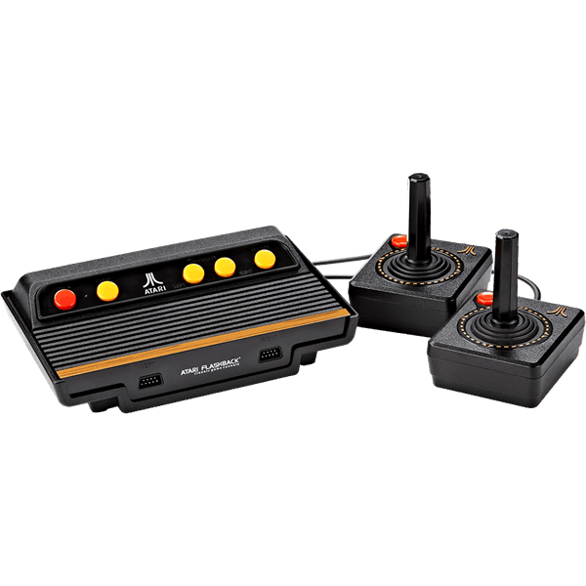

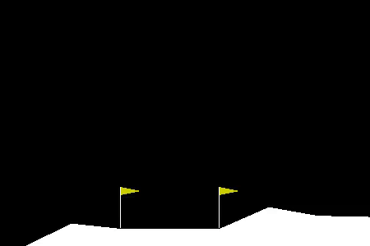
Interest
(a) Short-term interest
- ATARI
- Gym
(b) Long-term aim
Notes:
Make computer solve without any clue of what it has to do
Solve ATARI and Gym games → 4 games = common benchmark on which I have made all my experiments

Slide 6
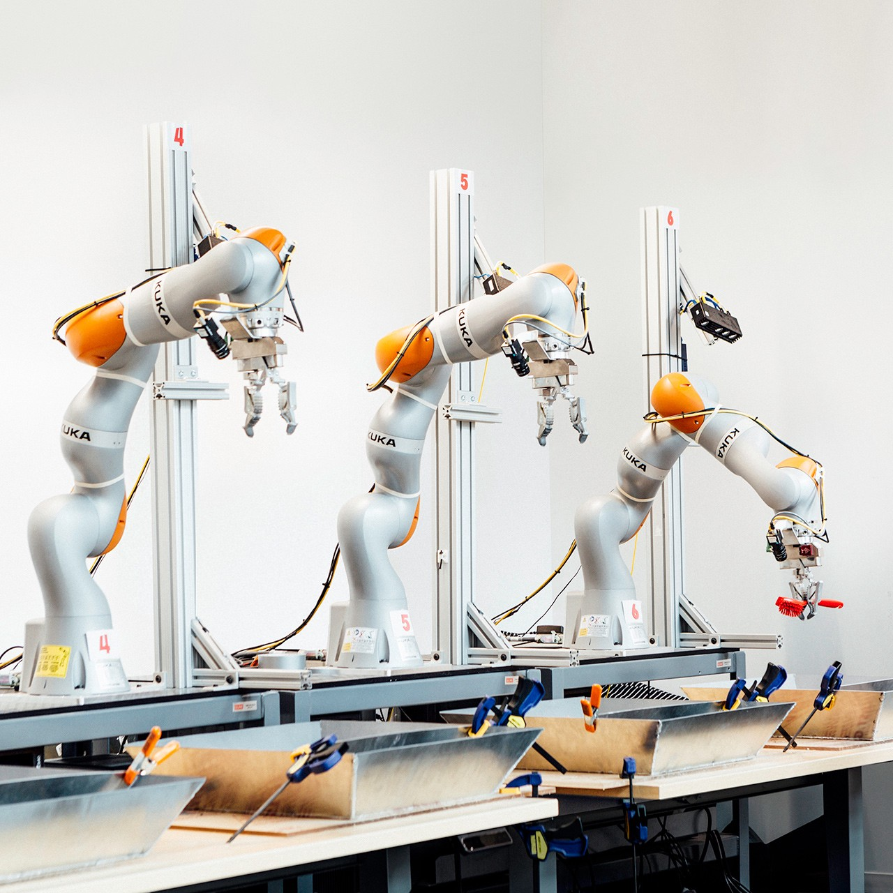
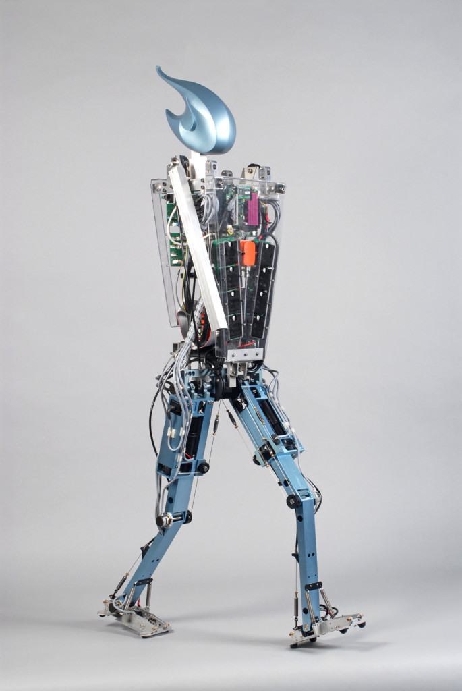
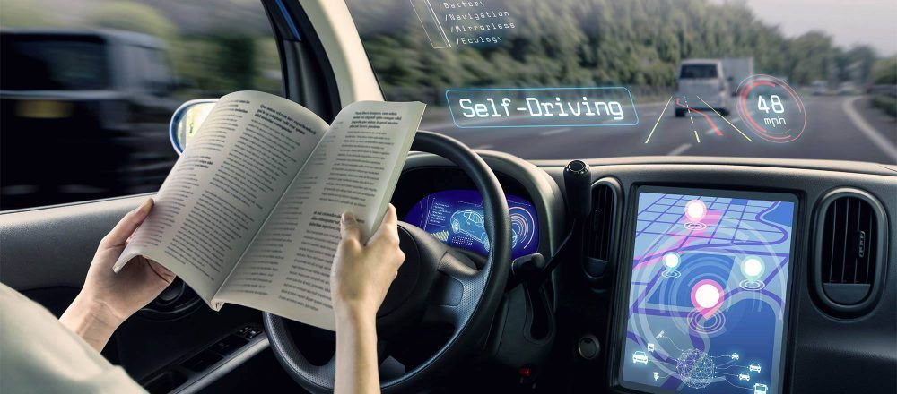
Interest
(a) Short-term interest
(b) Long-term aim
Notes:
Interesting perspectives = self-driving cars, computer visualization, robotics (walk)
=> Imagination is the limit (very hard to treat but promising and exciting)

Slide 7
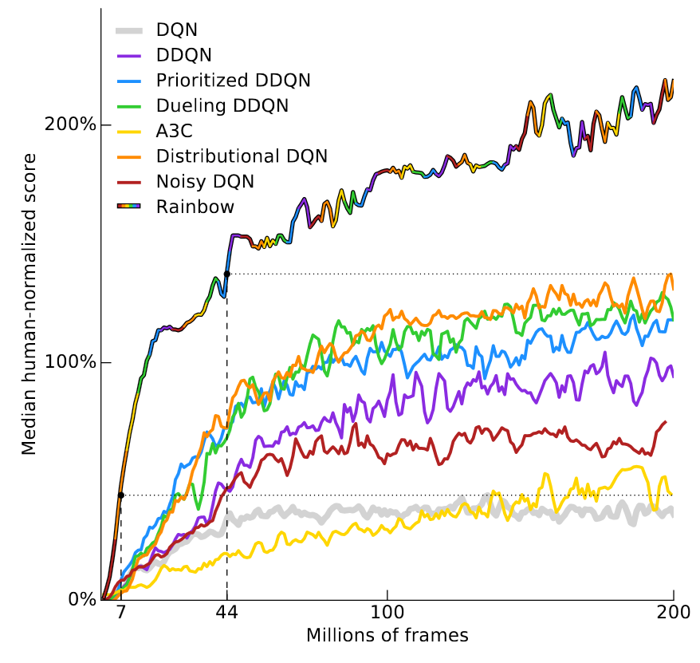
PIR TOPIC : RAINBOW ALGORITHM
DQN
+ Double DQN
+ Dueling DQN
+ Prioritized Replay
+ Multi-step Returns
+ Noisy Networks
+ Distributional DQN
= RAINBOW
Notes:
Rainbow = State-of-the-art algorithm ; paper published in 2017 by 10 Google Deepmind researchers.
Combining 6 major improvements to Deep Q-Networks algorithm (elementary)
Can see on the graph published with the paper that far better performance than uncombined individual improvements

Slide 8
PIR TOPIC : RAINBOW ALGORITHM
+ Double DQN
+ Dueling DQN
+ Prioritized Replay
+ Multi-step Returns
+ Noisy Networks
+ Distributional DQN
Notes:
Double DQN :
Classical : chose the action by evaluating each action’s impact on the long-term reward
Double DQN : first select the action using an other ‘target’ neural network, then evaluate it just once to know its impact
DQN → [ Rt+1 + γ*max[qθ (St+1, a’)] − qθ(St, At) ]²
DDQN → [ Rt+1+γ*qθ (St+1, argmax[qθ(St+1, a’)]) − qθ(St, At)]²
=> Addresses overestimation problem in the maximization step

Slide 9
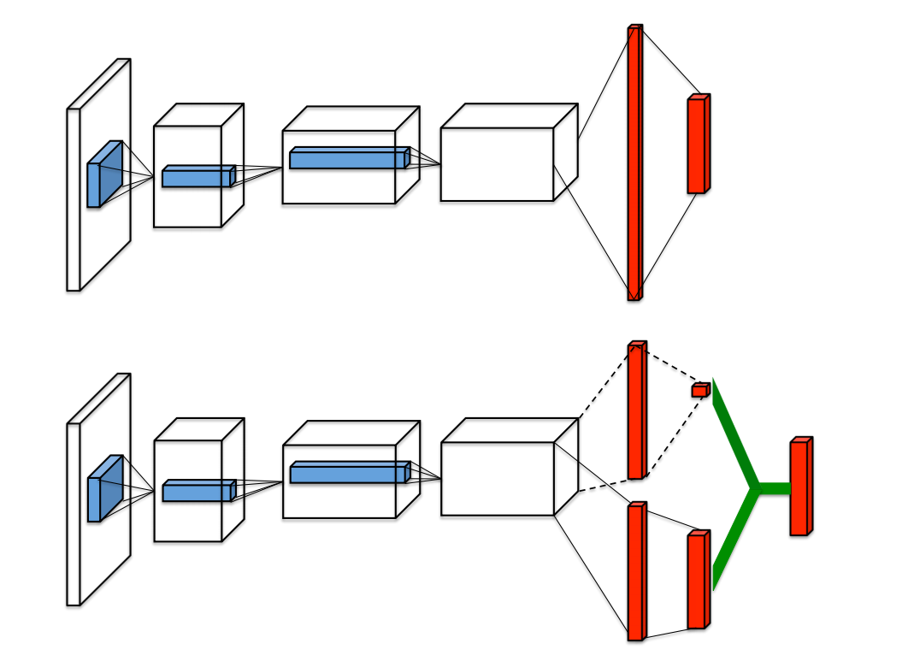
PIR TOPIC : RAINBOW ALGORITHM
+ Double DQN
+ Dueling DQN
+ Prioritized Replay
+ Multi-step Returns
+ Noisy Networks
+ Distributional DQN
Notes:
Dueling DQN :
In the neural network, we separate the output into two streams of computation : Value & Advantage
(= two elements needed in the calculations for the optimization of the network)
=> Data efficiency

Slide 10

Peer Topic : Rainbow algorithm
PIR TOPIC : RAINBOW ALGORITHM
+ Double DQN
+ Dueling DQN
+ Prioritized Replay
+ Multi-step Returns
+ Noisy Networks
+ Distributional DQN
Notes:
Prioritized Replay :
Classical DQN : store uniformly the past transitions in a buffer to ‘understand’ how to get better rewards
(example : in a given situation we need to fetch back ~similar situation memories to decide what to do)
PR : We class the transitions in the buffer by associating priorities and weights to take more into account the most interesting transitions. (learning potential)

Slide 11
Peer Topic : Rainbow algorithm
PIR TOPIC : RAINBOW ALGORITHM
+ Double DQN
+ Dueling DQN
+ Prioritized Replay
+ Multi-step Returns
+ Noisy Networks
+ Distributional DQN
Notes:
Multi-step learning :
Instead of using the last reward to compute the loss function, use a combination of the n last rewards
Instead of using the current state to compute the loss function, use evaluation of the n-previous state
=> Helps propagate the earlier observed rewards

Slide 12
Peer Topic : Rainbow algorithm
PIR TOPIC : RAINBOW ALGORITHM
+ Double DQN
+ Dueling DQN
+ Prioritized Replay
+ Multi-step Returns
+ Noisy Networks
+ Distributional DQN
Notes:
Noisy Networks :
Exploration = to get satisfying results, the algorithm mustn’t stop exploring new movements as soon as it gets some reward :
Example lunar lander → learns to fly but not to land => not bad results but clearly could do better
Add noisy layers into the neural network

Slide 13
Peer Topic : Rainbow algorithm
PIR TOPIC : RAINBOW ALGORITHM
+ Double DQN
+ Dueling DQN
+ Prioritized Replay
+ Multi-step Returns
+ Noisy Networks
+ Distributional DQN
Notes:
Instead of taking a mean of probabilities as output of the neural network, C51 gives the whole probability distribution of the potential reward as a histogram

Slide 14
Methods
1. Background acquisition
2. Bibliography work
3. Study of the codes
4. Implementation of the algorithm
5. Validation tests
Notes:
Background acquisition → long phase of initiation to RL
Bibliography work : initiation + Rainbow paper + all 6 improvements
Some codes for each improvement available on the internet
Implementation + tests and debugging while implementing
Tests after each improvement

Slide 15
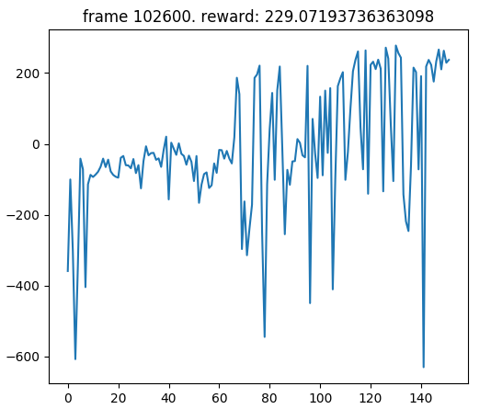
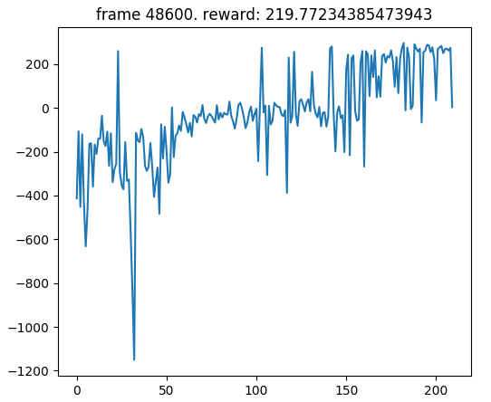
Results
(1) DQN
(2) Final Pseudo-Rainbow
Lunar Lander Benchmark
Abscissa : number of episodes ; Ordinates : Global reward
Notes:
Lunar Lander → 200 = solved
3 first : variance decreases slightly, still functional but no incredible modif
4 → accelerates (takes more into account the past rewards) but bigger variance around 200
5 → accelerates even more (better exploration) but still noisy
6 → ~convergence ; 3 phases (~random exploration + learns to fly→stabilization + learns to land→convergence)
7 → improved by Distributional ?

Slide 16
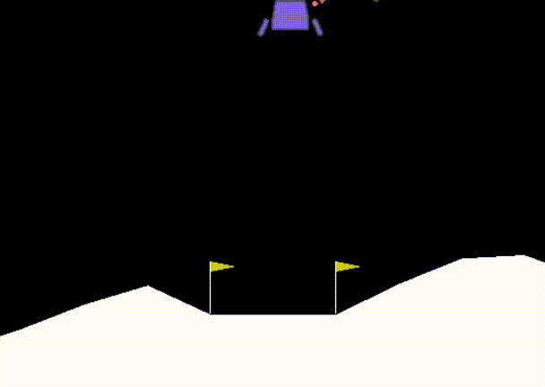
Results
(2) Final Pseudo-Rainbow
Notes:
Lunar Lander → 200 = solved
3 first : variance decreases slightly, still functional but no incredible modif
4 → accelerates (takes more into account the past rewards) but bigger variance around 200
5 → accelerates even more (better exploration) but still noisy
6 → ~convergence ; 3 phases (~random exploration + learns to fly→stabilization + learns to land→convergence)
7 → improved by Distributional ?

Slide 17
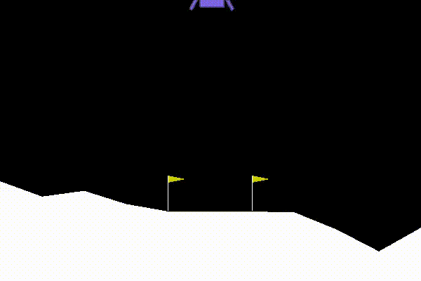
Results
(2) Final Pseudo-Rainbow
Notes:
Lunar Lander → 200 = solved
3 first : variance decreases slightly, still functional but no incredible modif
4 → accelerates (takes more into account the past rewards) but bigger variance around 200
5 → accelerates even more (better exploration) but still noisy
6 → ~convergence ; 3 phases (~random exploration + learns to fly→stabilization + learns to land→convergence)
7 → improved by Distributional ?

Slide 18
Results
(2) Final Pseudo-Rainbow
Notes:
Lunar Lander → 200 = solved
3 first : variance decreases slightly, still functional but no incredible modif
4 → accelerates (takes more into account the past rewards) but bigger variance around 200
5 → accelerates even more (better exploration) but still noisy
6 → ~convergence ; 3 phases (~random exploration + learns to fly→stabilization + learns to land→convergence)
7 → improved by Distributional ?

Slide 19
ENCOUNTERED DIFFICULTIES
- Initiation to Reinforcement Learning
- Working on other people’s codes
- Limited time
- Difficulty of the task
Notes:
Initiation = continuous (100% beginning, then 50%)
Working = needs much flexibility and time → test functionnalities, comment everything
Time => overestimation of the things I could manage, due to difficulties above too (less than 1month and a half full time & some weeks part-time)
Difficulty = State-of-the-art algorithm on which 10 eminent researchers spent full-time months and maybe years
Difficulty = have to test each incremental addition to the code, debug, unit testing, functional testing

Slide 20
Conclusions
- Evolution of the initial topic
- Research contribution
- Future works
- Personal impact
Notes:
Initially, Rainbow++ with Implicit Quantile Networks (improv Distributional DQN with continuous probability-return mapping → better approximation)
Time => only rainbow, not the time to finish
Gave SuReLI an almost-complete rather functional Rainbow to work with
Future works = Distributional DQN + Implicit Quantile Network -> ++
Experiments on other environments (longer & more difficult)
Hyperparameters
Personal → gave research methods, improved coding skills, learn bibliography, interesting subject, global knowledge

Slide 21
Thank you for your attention. Questions ?

Slide 22
BIBLIOGRAPHY
Mnih et al. “Playing Atari with Deep Reinforcement Learning”, NIPS 2013
Hessel et al. “Rainbow: Combining Improvements in Deep Reinforcement Learning”, AAAI 2018
Van Hasselt et al. “Deep reinforcement learning with double q-learning”, CoRR 2015
Wang et al. “Dueling network architectures for deep reinforcement learning”, CoRR 2015.
Sutton & Barto “Reinforcement learning : An introduction”, IEEE 1998
Fortunato et al. “Noisy networks for exploration”, CoRR 2017
Schaul et al. “Prioritized experience replay“, CoRR 2016
Bellemare et al. “A Distributional Perspective on Reinforcement Learning”, ICML 2017
Dabney et al. “Implicit Quantile Networks for Distributional Reinforcement Learning”, ICML 2018

